Slide 1
An Inside Look at Curriculum Development
By: Jill Jezek
2nd grade teacher
Frank V. Bergman Elementary

Slide 2
“Why would a school need a new curriculum?”
Curriculum is not meeting the needs of students.
USD #383 Manhattan-Ogden felt it’s current elementary mathematics curriculum, Investigations Math, was not challenging enough for students.
Student math scores were decreasing year after year on standardized tests
The final year of Investigations, a couple of the schools did not make AYP in Math.
It was time for a change.

Slide 3
The Interview
Goal: To find out how a district curriculum committee selected a new mathematics curriculum for its elementary schools
Interviewee: 2nd grade teacher Mrs. Christi Packard*
She has taught for 26 years and currently is the Math Lead Teacher for her building.
*Name has been changed

Slide 4
Curriculum Selection Process
Curriculum Committee was made up of:
All Math Lead teachers in the district, other teachers, parents, administrators, KSU professionals, and a board member
First, they looked at many different math series and narrowed it down to four.
Next, those companies came to Manhattan and gave presentations on their programs. Committee members also observed the programs being used in different schools. A few went to the NCTM Math Conference in Nashville, TN, to learn even more about each of the programs.
Finally, they narrowed it down to the top two and voted on their final selection, majority ruled.
Total Time: 7 months

Slide 5
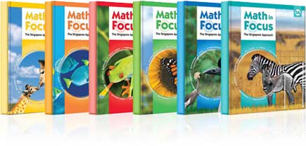
And the winner is…
Math in Focus: The Singapore Approach
Follows the Singapore math pedagogy:
“fewer topics taught in greater depth at each grade level”
http://youtu.be/32fFQ_mu_BY

Slide 6
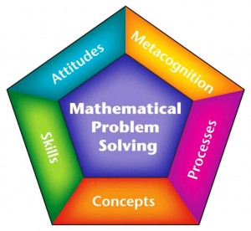
What does this selection imply about the district’s curriculum?
“It is focused on subject matter and mastery learning that meets the needs of the classroom.”
- Christi Packard
-District wanted a curriculum that was going to improve students’ mathematical scores on the high-stakes standardized tests.
“Who’s approach do you think
Math in Focus follows?”

Slide 7
Tyler’s (1949) rational-linear approach vs. Math in Focus approach
Characteristics of Tyler’s approach:
Stated explicit objectives, experiences needed to achieve these objectives, teacher-directed delivery methods along with concept development, vertical and horizontal development and finally objective-based tests along with informal evaluations.
Math in Focus approach:
clear objectives stated for every lesson and unit
direct instruction and modeling by the teacher
guided practice with exploration of materials
teacher informally observes students to judge whether they are ready for independent practice
knowledge is tested with objective based tests at the end of every chapter

Slide 8
Conclusion
We are still responding to the NCEE report: A Nation at Risk (1983)
Schools teach a few basic academic subjects, spends more time these subjects, test students more, and measures the results more frequently.
Is it what's best for our students? Yes, as long as we feel what’s best for our students is a curriculum that will raise their test scores.
Questions? Comments?

